Slide 1
Comparison of Molecular Structures
Acta Crystallographica (1989). A45, 208 - 210
Yue Zhengyuan (15307110235)
December 15, 2017

Slide 2
Sketch of the Problem
We have two slightly different molecule. To compare their structure, we should first superpose one on the other as much as possible.
Steps:
Find the centroid in each molecule, and move them together (easy)
Find the rotation matrix needed, by minimizing the sum of the squared distances between the atoms

Slide 3
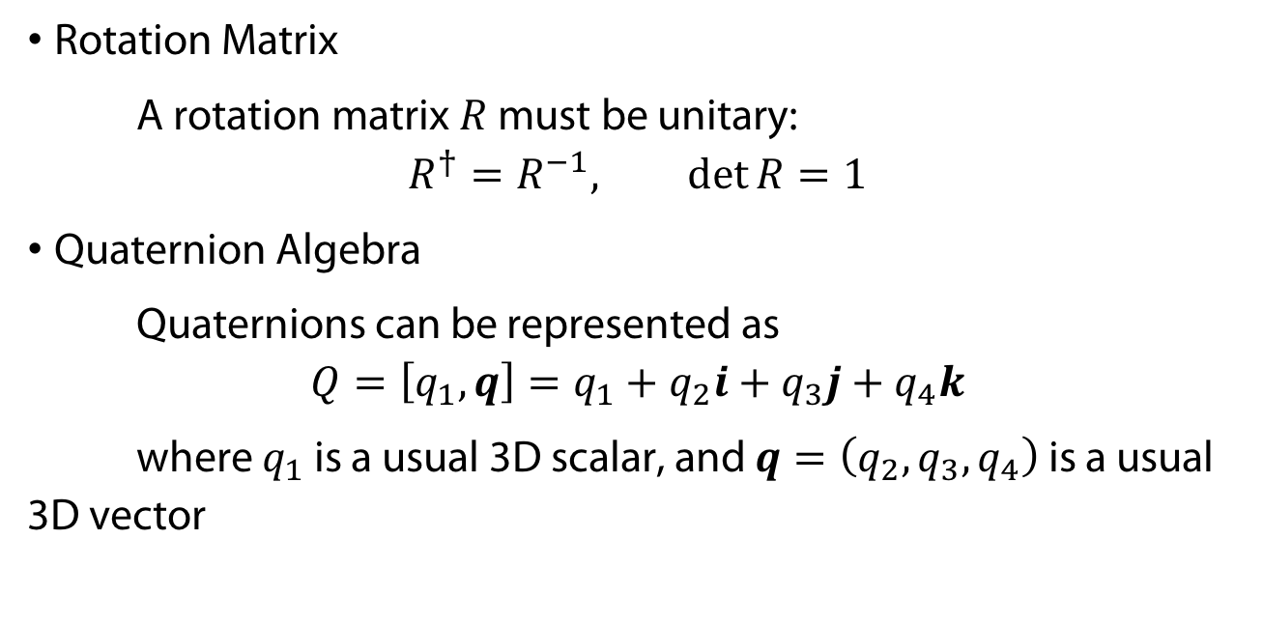
Mathematical Background
Rotation Matrix
A rotation matrix $R$ must be unitary:
$$R^{†}=R^{−1}, \det{R}=1$$
Quaternion Algebra
Quaternions can be represented as
$$Q=\left[q_{1},q\right]=q_{1}+q_{2}i+q_{3}j+q_{4}k$$
where $q_{1}$ is a usual 3D scalar, and $q=\left(q_{2},q_{3},q_{4}\right)$ is a usual 3D vector

Slide 4
Quaternion Multiplication Table
× | 1 | i | j | k
1 | 1 | i | j | k
i | i | -1 | k | -j
j | j | -k | -1 | i
k | k | j | -i | -1

Slide 5
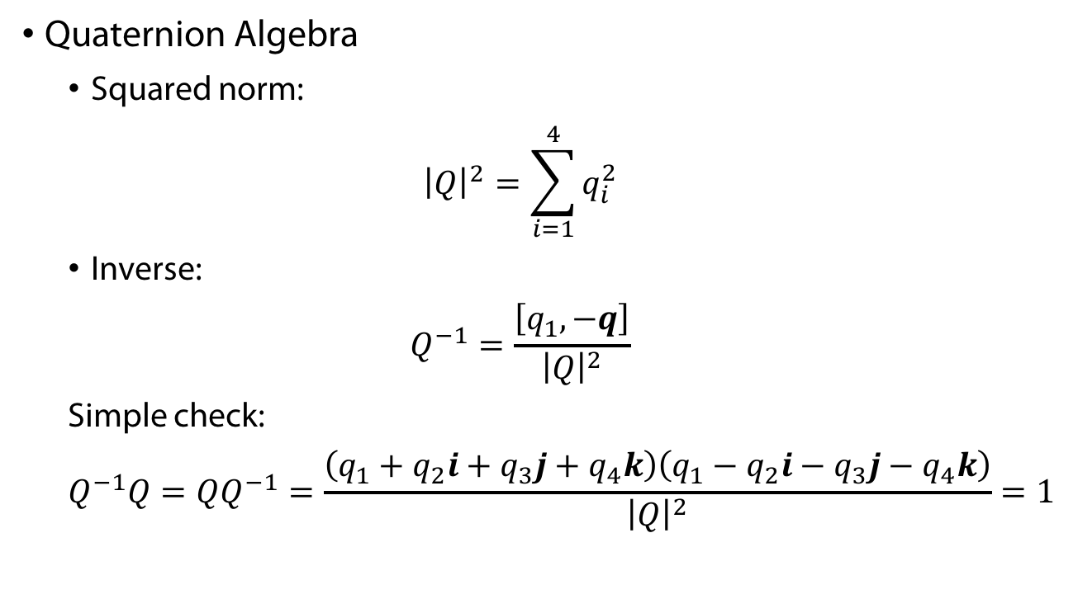
Mathematical Background
Quaternion Algebra
Squared norm:
$${\left|Q\right|}^{2}=\sum_{i=1}^{4}{q_{i}^{2}}$$
Inverse:
$$Q^{−1}=\frac{\left[q_{1},−q\right]}{{\left|Q\right|}^{2}}$$
Simple check:
$$Q^{−1}Q=QQ^{−1}=\frac{\left(q_{1}+q_{2}i+q_{3}j+q_{4}k\right)\left(q_{1}−q_{2}i−q_{3}j−q_{4}k\right)}{{\left|Q\right|}^{2}}=1$$

Slide 6
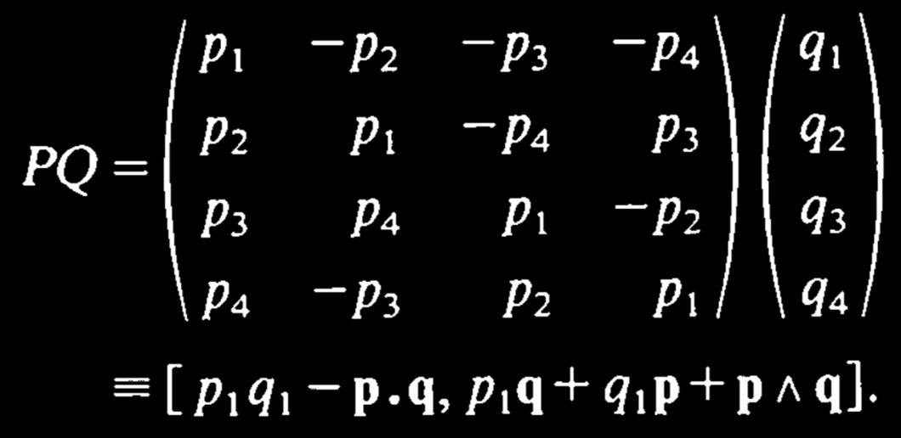
Mathematical Background
Matrix Representation of Quaternion Multiplications

Slide 7
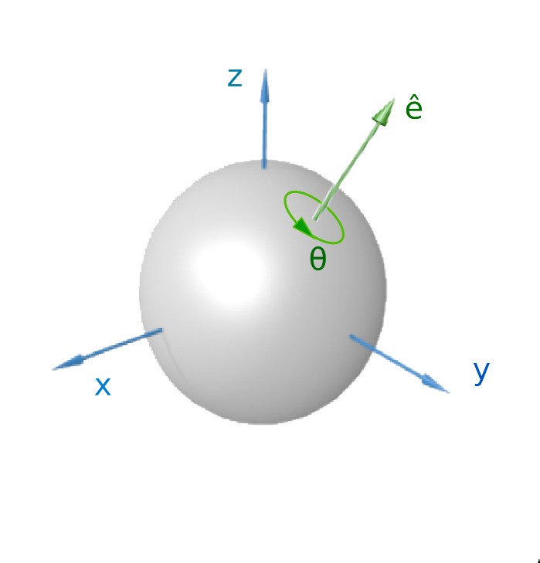

Quaternion and Spatial Rotation
A rotation through an angle $θ$ around the axis defined by a unit vector
$$u=\left(u_{x},u_{y},u_{z}\right)=u_{x}i+u_{y}j+u_{z}k$$
can be represented by a quaternion, using the generalized Euler‘ s formula
$$Q=\exp\left[\frac{θ}{2}\left(u_{x}i+u_{y}j+u_{z}k\right)\right]=\cos{\frac{θ}{2}}+\left(u_{x}i+u_{y}j+u_{z}k\right)\sin{\frac{θ}{2}}$$

Slide 8
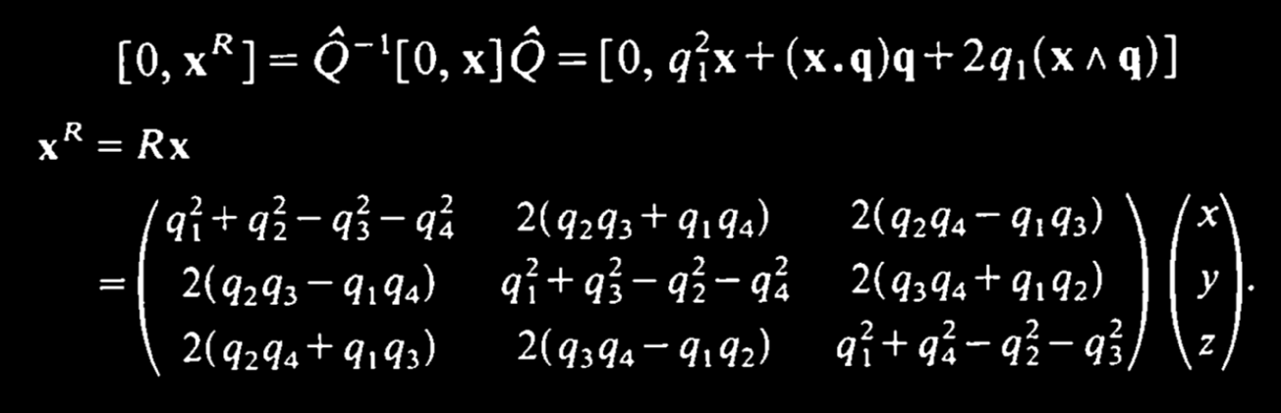

Quaternion and Spatial Rotation
Let $\left|Q\right|=1$, and regard vector $x$ as a quaternion with zero scalar component ($X=\left[0,x\right]$). Then

Slide 9
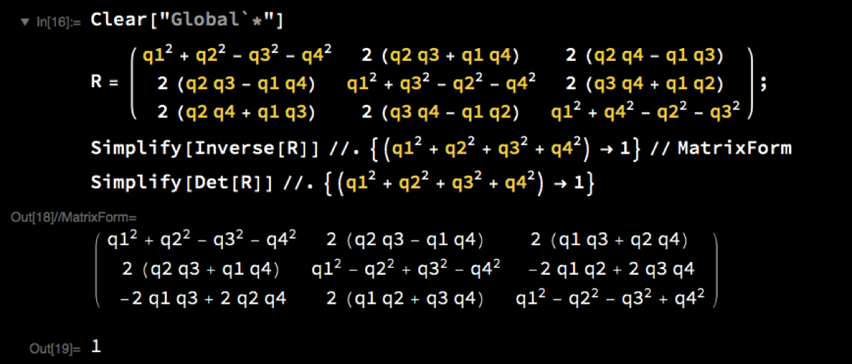
Quaternion and Spatial Rotation
A Simple Check: This $R$ is indeed unitary !

Slide 10

Finding the Rotation Matrix
After moving the centroids together and rotated one of the molecules, the corresponding vectors $x$ and $x^{′}$ are still different
$$\left[0,e\right]=\left[0,x^{′}\right]−Q^{−1}\left[0,x\right]Q$$
we should minimize
$$\sum{\left|e\right|}=\sum{\left|\left[0,e\right]\right|}$$

Slide 11

Finding the Rotation Matrix
To make the problem algebraically tractable, we use the quantity
$$Q\left[0,e\right]=Q\left[0,x^{′}\right]−QQ^{−1}\left[0,x\right]Q=Q\left[0,x^{′}\right]−\left[0,x\right]Q$$
and minimize
$$ε≡\sum{\left|Q\left[0,e\right]\right|}=\sum{{\left|Q\right|}^{2}}{\left|e\right|}^{2}={\left|Q\right|}^{2}\sum{{\left|e\right|}^{2}}=\sum{{\left|\left[−q∙\left(x^{′}−x\right),q_{1}\left(x^{′}−x\right)+q×\left(x^{′}+x\right)\right]\right|}^{2}}$$
under the condition ${\left|Q\right|}^{2}=1$

Slide 12
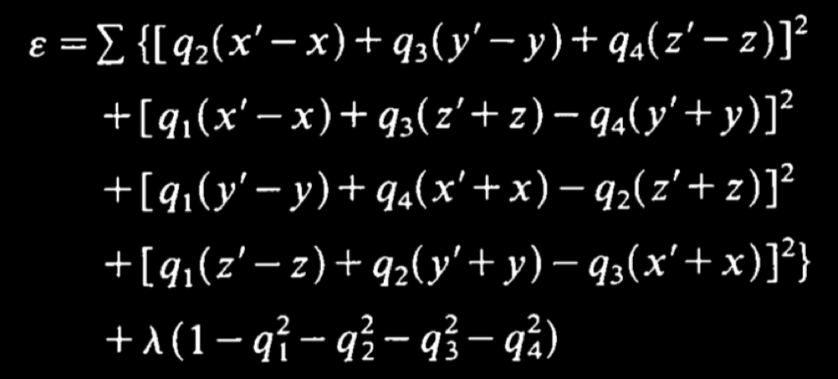
Finding the Rotation Matrix
Introducing a Lagrange multiplier to rewrite $ε$ as

Slide 13

Finding the Rotation Matrix
Conditions:
$$\frac{∂ε}{∂q_{i}}=0, i=1,2,3,4$$
$${\left|Q\right|}^{2}=q_{1}^{2}+…+q_{4}^{2}=1$$
Setting $x_{m}=x^{′}−x$, $x_{p}=x^{′}+x$, we obtain a matrix equation

Slide 14
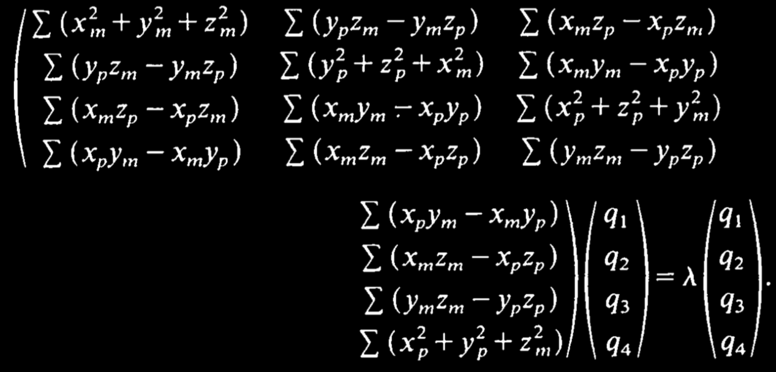
Finding the Rotation Matrix
An Eigenvalue Problem !

Slide 15

Meaning of the Eigenvalue $λ$

